Slide 1
Open Source
and Enterprise

Slide 2
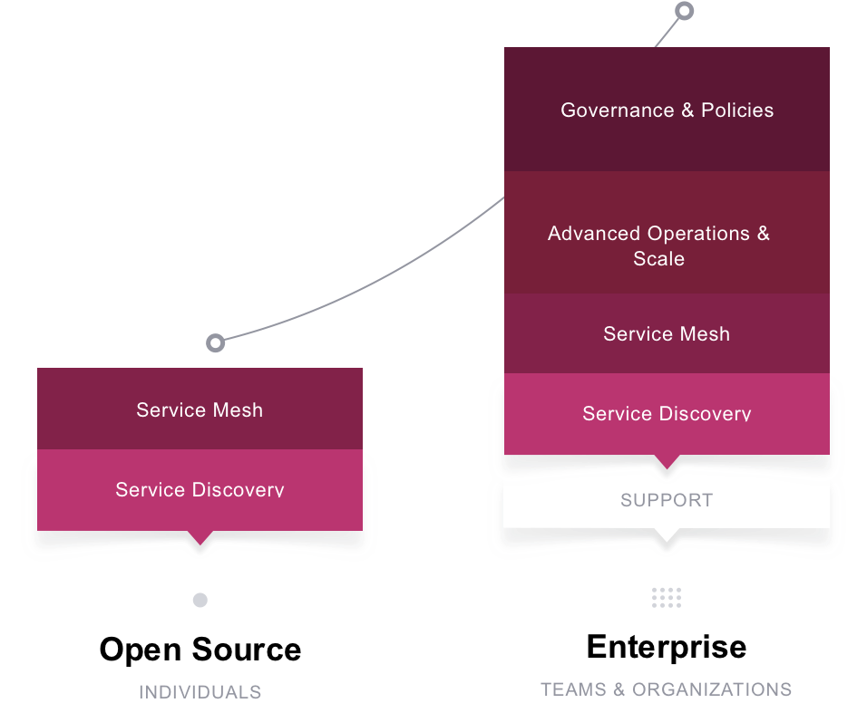
Consul Packages
Consul Enterprise adds operations, governance, and scalability features for teams and organizations
OPEN SOURCE AND ENTERPRISE

Slide 3
Consul Enterprise Business Value
Reduce Risk
Increase Productivity
Enable Advanced Network Topologies
MITIGATE DOWNTIME DISRUPTION
Avoid downtime disruption for business critical applications without compromising performance
EASE ADMINISTRATIVE BURDEN
Efficiently manage complex network at scale without additional operational complexity and performance degradation
ENHANCE USABILITY
Support complex network topologies with advanced communication pattern to meet organization’s business or regulatory requirements
A scalable and reliable service networking platform to support modern applications and multi-cloud deployments.
OPEN SOURCE AND ENTERPRISE

Slide 4
1
Automated Backups
Enable a highly reliable backup process for disaster recovery by automatically saving and restoring the state of Consul servers
Consul Enterprise
Platform
Improve platform reliability and minimize downtime impact
2
Automated Upgrades
Support zero-downtime upgrade and avoid version incompatibility through gracefully promoting and demoting Consul servers without needing operator intervention
3
Redundancy Zones
Improve resiliency by supporting advanced Consul deployment pattern within an availability zone.
OPEN SOURCE AND ENTERPRISE
© 2019 HashiCorp
‹#›

Slide 5
1
Enhanced Read Scalability
Ensure performance at scale by allowing additional read throughput without impacting write latency
Consul Enterprise
Global Visibility, Routing & Scale
Manage complex network topologies in a multi- datacenter/cloud environment with improved scalability
2
Network Segments
Support isolated network subnet deployment within a region by creating isolated LAN segments.
3
Advanced Federation
Support complex network topologies (such as hub-and-spoke) by allowing to specify a relationship between any pair of regions.
OPEN SOURCE AND ENTERPRISE
© 2019 HashiCorp
‹#›

Slide 6
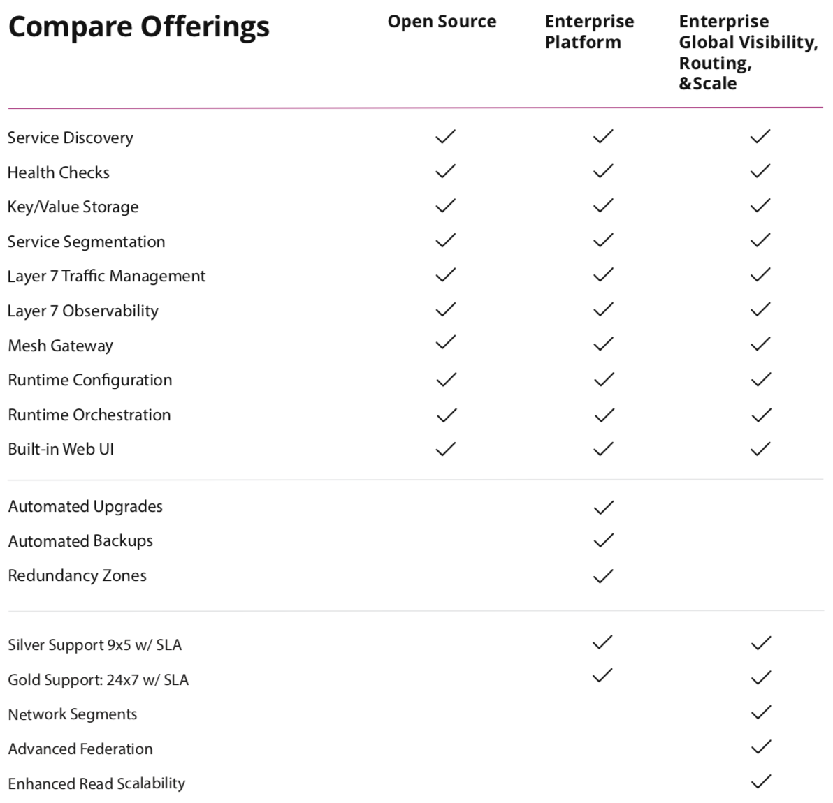
Compare Packages
OPEN SOURCE AND ENTERPRISE

